Slide 1
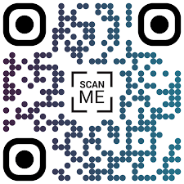
Your Logo
    Keep it Simple: Use a clean and uncluttered layout. Limit the amount of text and focus on key points.
    Visual Hierarchy: Use headings, bullet points, and varying font sizes to guide the viewer’s eye through the poster.
    Incorporate Figures and Images: Use graphs, charts, and images to illustrate your points. Visuals can help convey complex data more clearly.
    Color Contrast: Ensure good contrast between text and background colors for readability.
    Please use standard template fonts (Time New Roman, Arial, Calibri, Calibri Light)
    Logical Flow: Organize content in a logical sequence (e.g., Introduction, Methods, Results, Conclusion).
    Limit Text: Aim for concise explanations. Use short sentences and avoid jargon where possible.
Engage with Attendees: Be prepared to explain your poster and answer questions. Practice your pitch to convey your research succinctly.
Know Your Audience: Tailor your explanations based on the attendees’ backgrounds and interests.
Provide Takeaways: Consider having handouts summarizing your research or providing contact information for further discussion.
Add a QR-code with additional information
Encourage Interaction: Stand by your poster and invite attendees to ask questions. Be open to feedback and discussions.
  Be Mindful of Time: If the session has a specific duration, manage your time to ensure you can engage with multiple attendees.
  By following these recommendations, you can create an effective and engaging poster session that effectively communicates your research!

