Slide 1
Paper Title for the 2025 Antenna Measurement Techniques Association (AMTA)
George W. Bush¹, Barack Obama², Donald Trump³ and Joe Biden⁴
¹Yale University, Connecticut, U.S.
²Columbia University, New York, U.S.
³University of Pennsylvania, Pennsylvania, U.S.
⁴University of Delaware, Delaware, U.S.
Nov. 03. 2025

Slide 2
Presentation Suggestions
Your Logo
Here
Design Clarity
Keep it Simple: Use a clean and uncluttered layout. Limit the amount of text and focus on key points.
Visual Hierarchy: Use headings, bullet points, and varying font sizes to guide the viewer’s eye through the presentation.
Use Visuals Effectively
Incorporate Figures and Images: Use graphs, charts, and images to illustrate your points. Visuals can help convey complex data more clearly.
Color Contrast: Ensure good contrast between text and background colors for readability.
Please use standard template fonts (Time New Roman, Arial, Calibri, Calibri Light)
Content Organization
Logical Flow: Organize content in a logical sequence (e.g., Introduction, Methods, Results, Conclusion).
Limit Text: Aim for concise explanations. Use short sentences and avoid jargon where possible.
Practice Your Presentation several times. Be sure you can finish in 15 minutes
Engage with Attendees: Be prepared to explain your presentation and answer questions. Practice your pitch to convey your research succinctly.
Know Your Audience: Tailor your explanations based on the attendees’ backgrounds and interests.
Add a QR-code with additional information

Slide 3
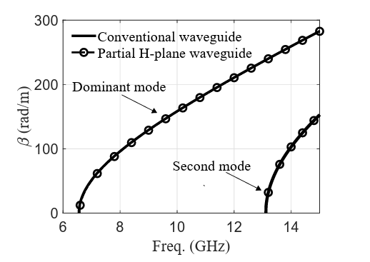
Presentation Suggestions
Your Logo
Here
Use company logos in the upper right
Times New Roman, Arial, Calibri are typically used
Integrate text with visuals to have better impact on your presentation.
Relying solely on text will not effectively captivate attendees
15 slides are appropriate for a 15 minute presentation
While MS Power Point will scale fonts, try to keep fonts at least 16 point at smallest
Ensure figures have legible axes/labels (recommend 14-pt or larger equivalent font on slide)
3

Slide 4
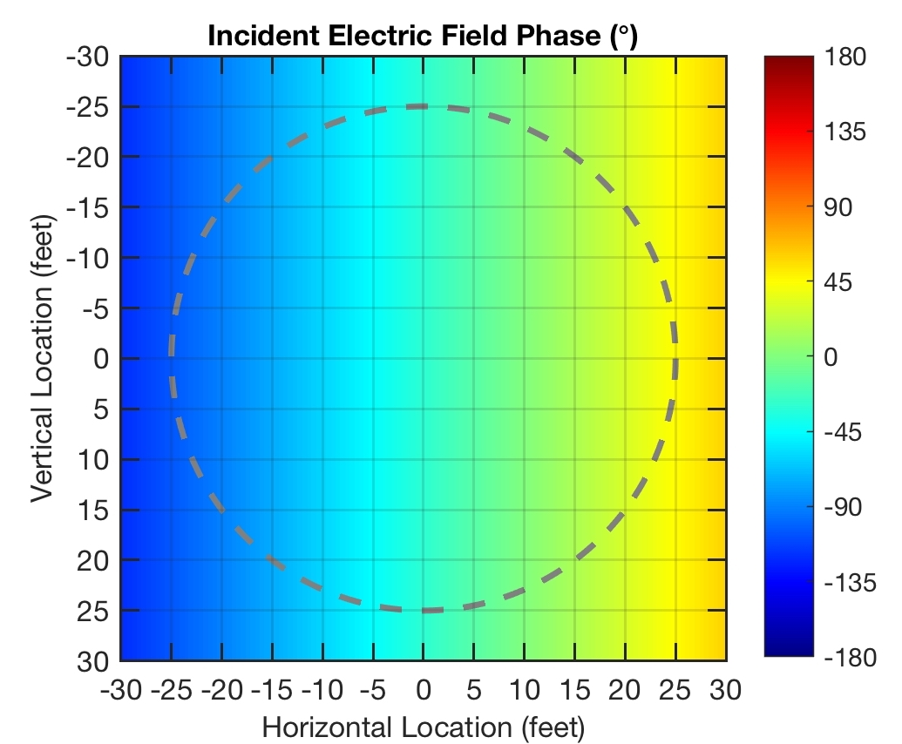
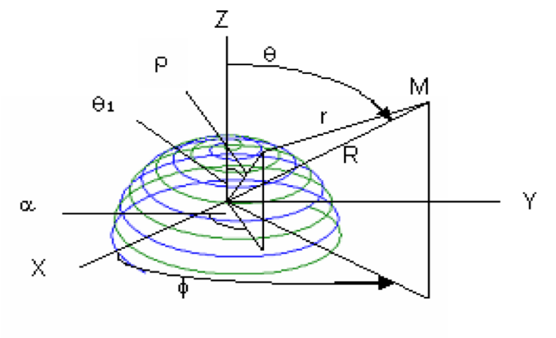
Figure Guidelines
Your Logo
Here
Define symbols in figures as necessary
Ensure figures have legible axes/labels (recommend 14-pt or larger equivalent font on slide)
Maximize figure size for ease of viewing for audience
Common symbols don’t need defining
Add references if the material presented is not yours!
S. Lange, D. Schröder, C. Hedayat, C. Hangmann, T. Otto and U. Hilleringmann, "Investigation of the Surface Equivalence Principle on a Metal Surface for a Near-Field to Far-Field Transformation by the NFS3000," 2020 International Symposium on Electromagnetic Compatibility - EMC EUROPE, Rome, Italy, 2020, pp. 1-6, doi: 10.1109/EMCEUROPE48519.2020.9245697.

